Slide 1
RIP
The Routing Information Protocol (RIP) is an intradomain routing protocol used inside an autonomous system.
It is a very simple protocol based on distance vector routing.

Slide 2
RIP implements distance vector routing directly with some considerations:
In an autonomous system, we are dealing with routers and networks (links). The routers have routing tables; networks do not.
The destination in a routing table is a network, which means the first column defines a network address.
The metric used by RIP is very simple; the distance is defined as the number of links (networks) to reach the destination. For this reason, the metric in RIP is called a hop count.

Slide 3
Infinity is defined as 16, which means that any route in an autonomous system using RIP cannot have more than I5 hops.
The next-node column defines the address of the router to which the packet is to be sent to reach its destination.

Slide 4
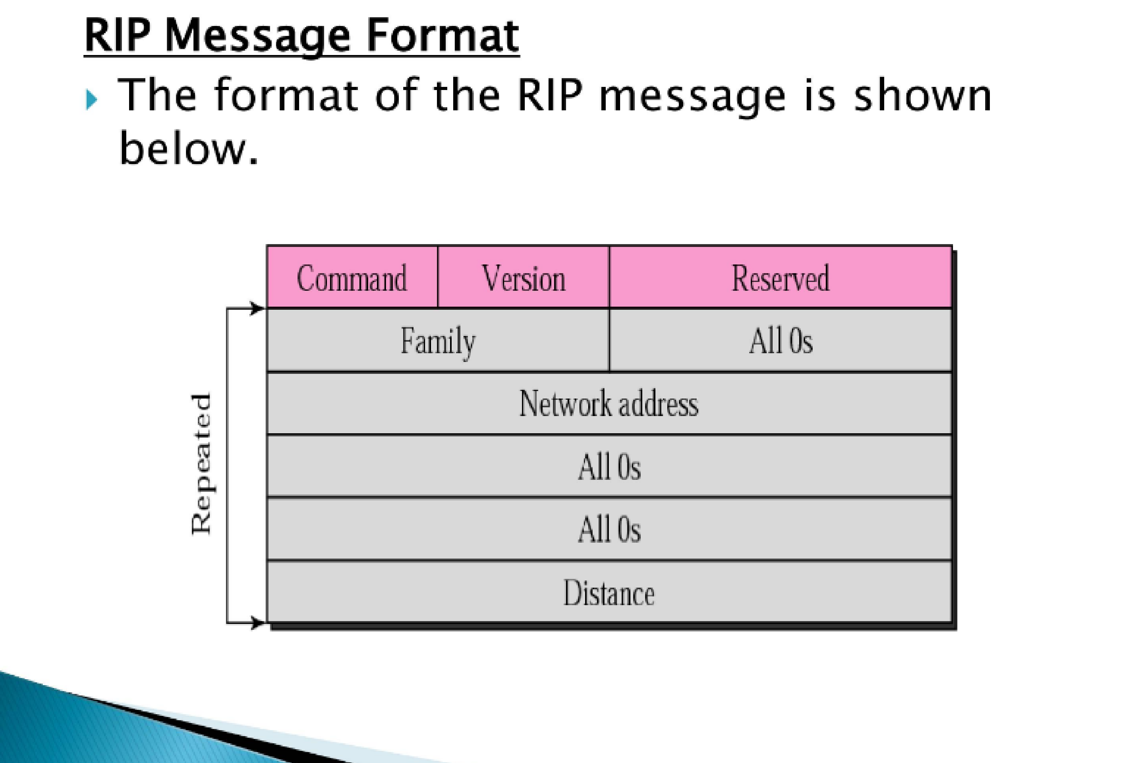

Slide 5
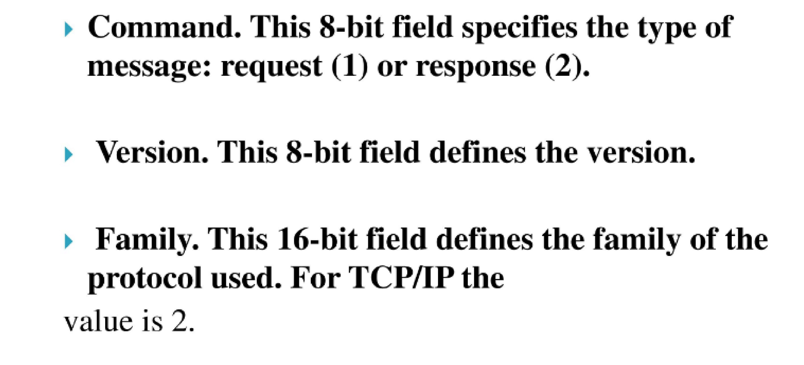

Slide 6
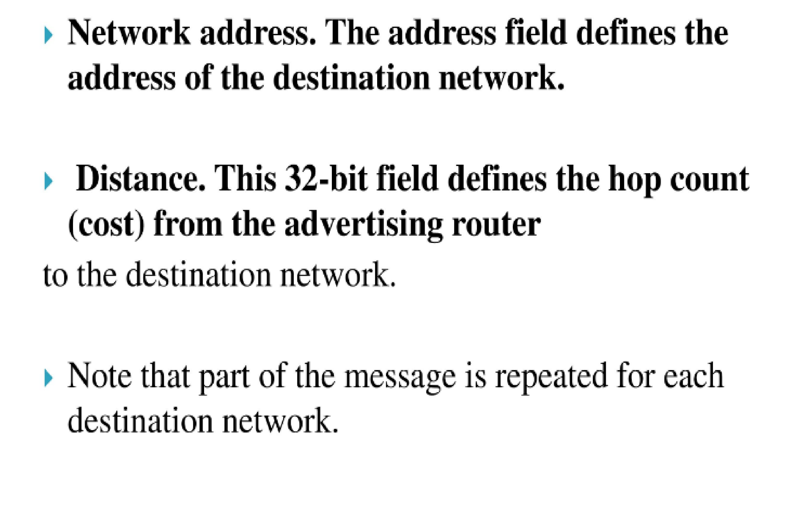

Slide 7
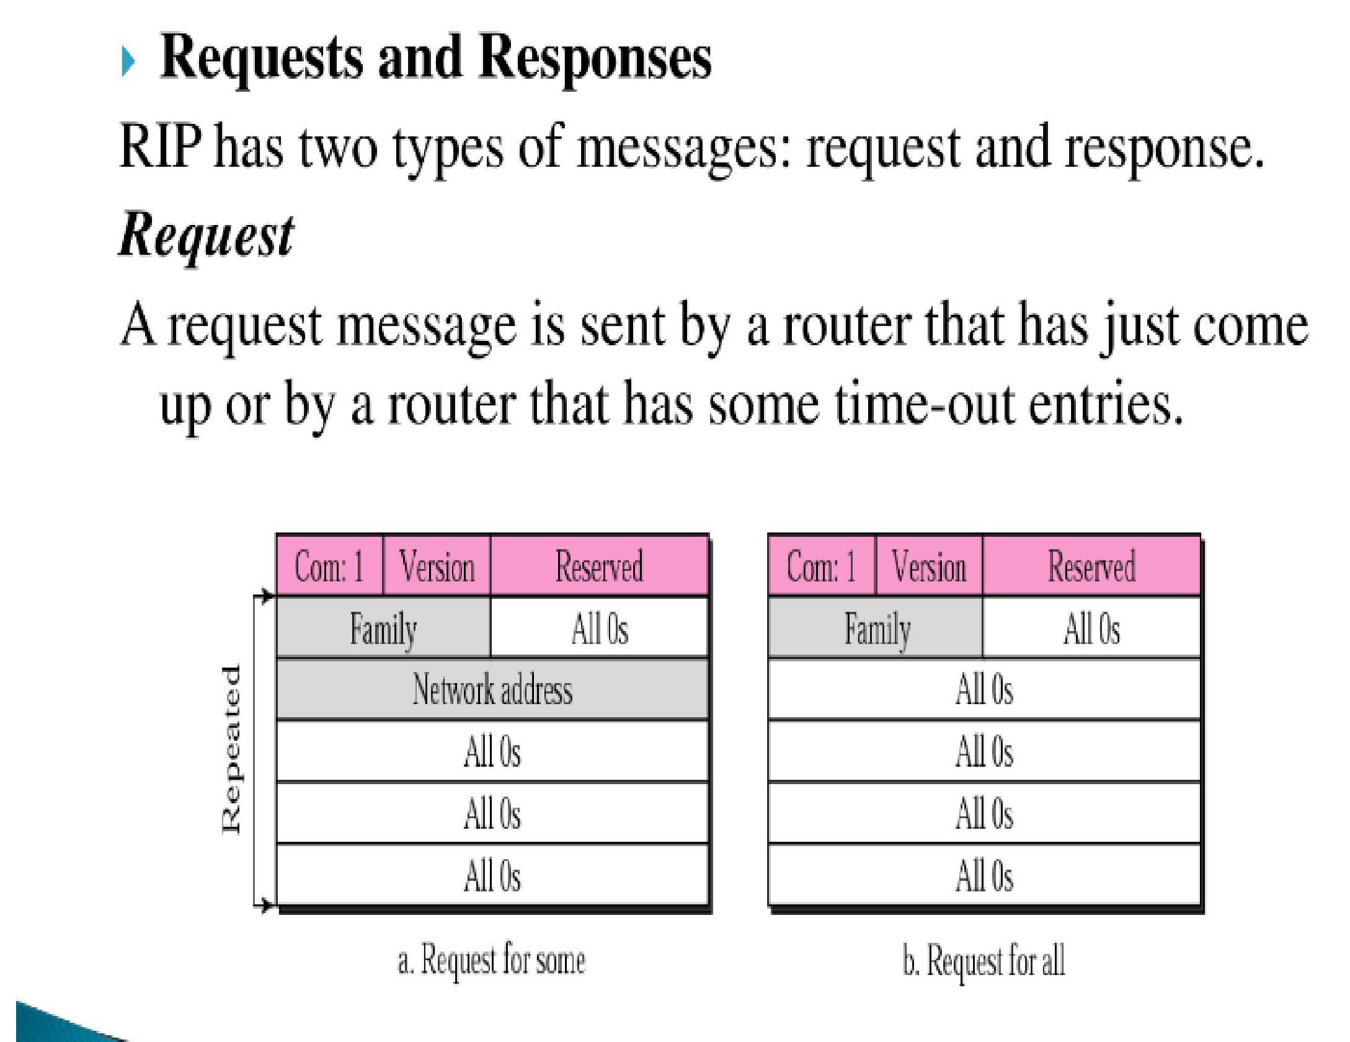

Slide 8
Response
A response (or update) message can be either solicited or unsolicited.
A solicited response message is sent only in answer to a request message. It contains information about the destination specified in the corresponding request message.
An unsolicited response message, on the other hand, is sent periodically, every 30 seconds or when there is a change in the routing table.
The response is sometimes called an update packet.

Slide 9
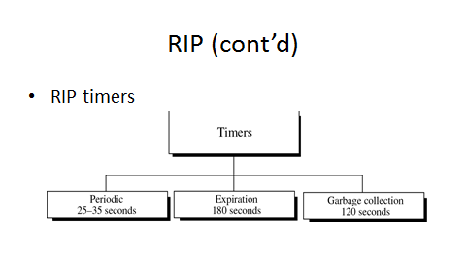

Slide 10
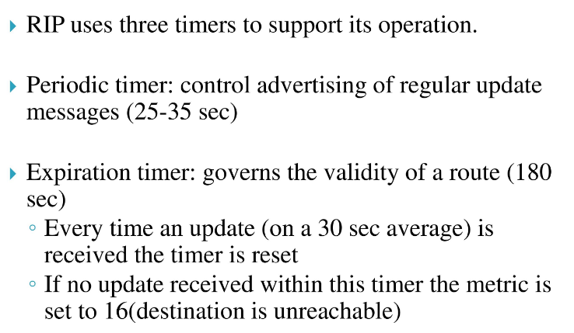

Slide 11
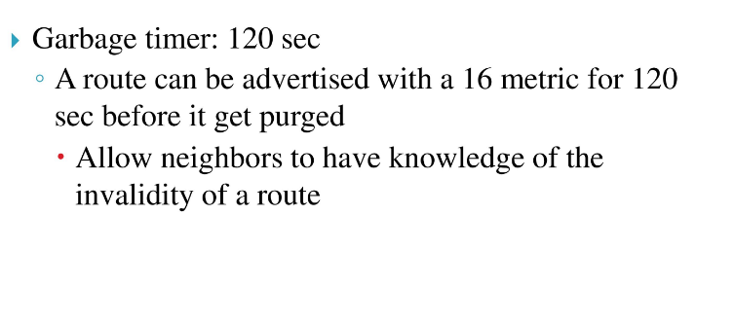

Slide 12
RIPv2
RIPv2 extends RIPv1:
Subnet masks are carried in the route information.
Authentication of routing messages.
Route information carries next-hop address.
Exploits IP multicasting.
Extensions of RIPv2 are carried in unused fields of RIPv1 messages.

Slide 13
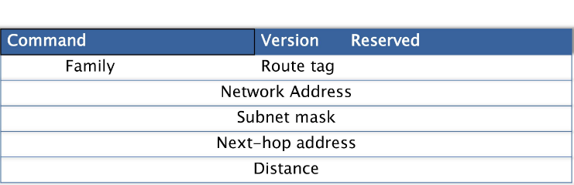
RIPv2

Slide 14
RIP Problems
RIP takes a long time to stabilize
Even for a small network, it takes several minutes until the routing tables have settled after a change
RIP has all the problems of distance vector algorithms, e.g., count-to-Infinity
RIP uses split horizon to avoid count-to-infinity
The maximum path in RIP is 15 hops

